Slide 1
Making Your RAG-Chatbot

Slide 2
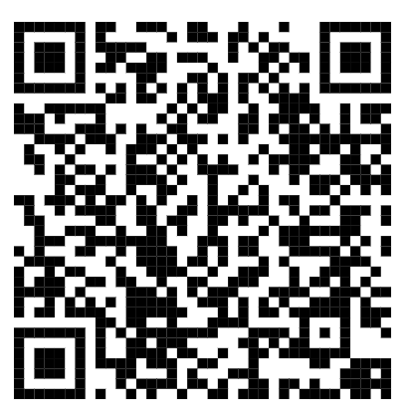
This slide

Slide 3
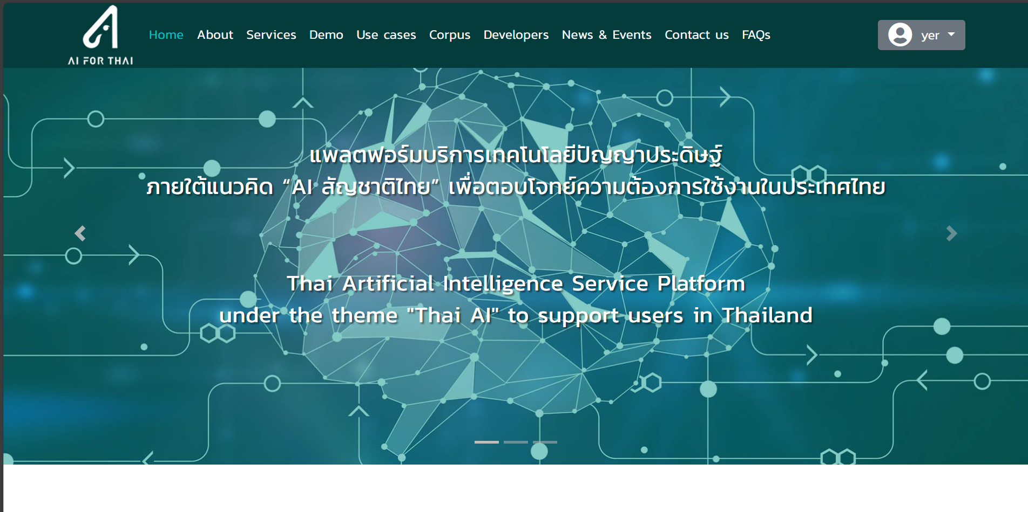
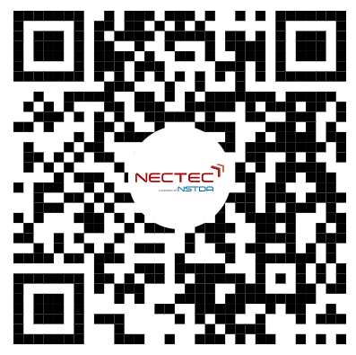
https://aiforthai.in.th

Slide 4
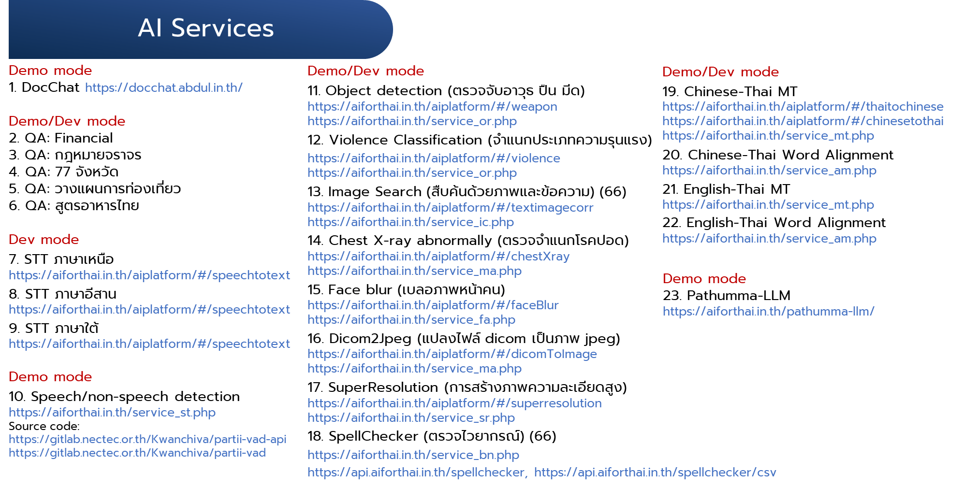

Slide 5
TOOLS

Slide 6




Chat channel
Automate workflow
Free LLM provider
Free public host

Slide 7
webhook
Access token

Slide 8
LINE CHATBOT AGENT

Slide 9
https://developers.line.biz
Updated on 2025.01.30

Slide 10
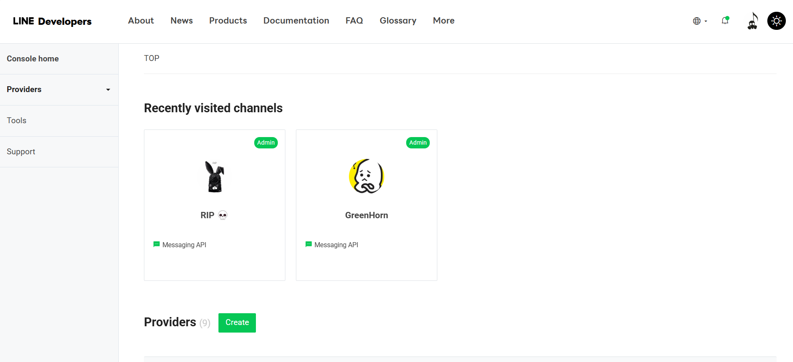

Slide 11
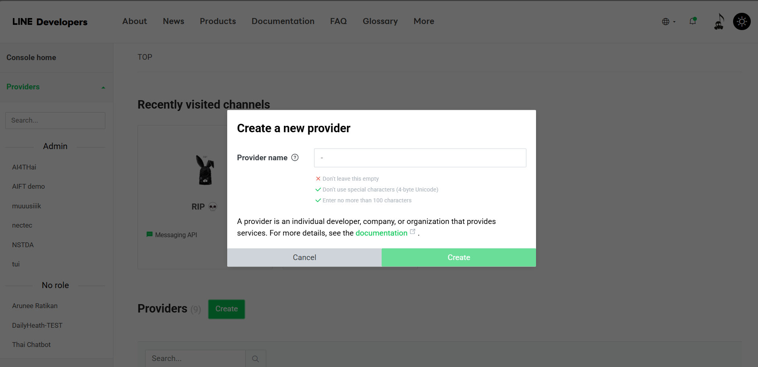
Create a name

Slide 12
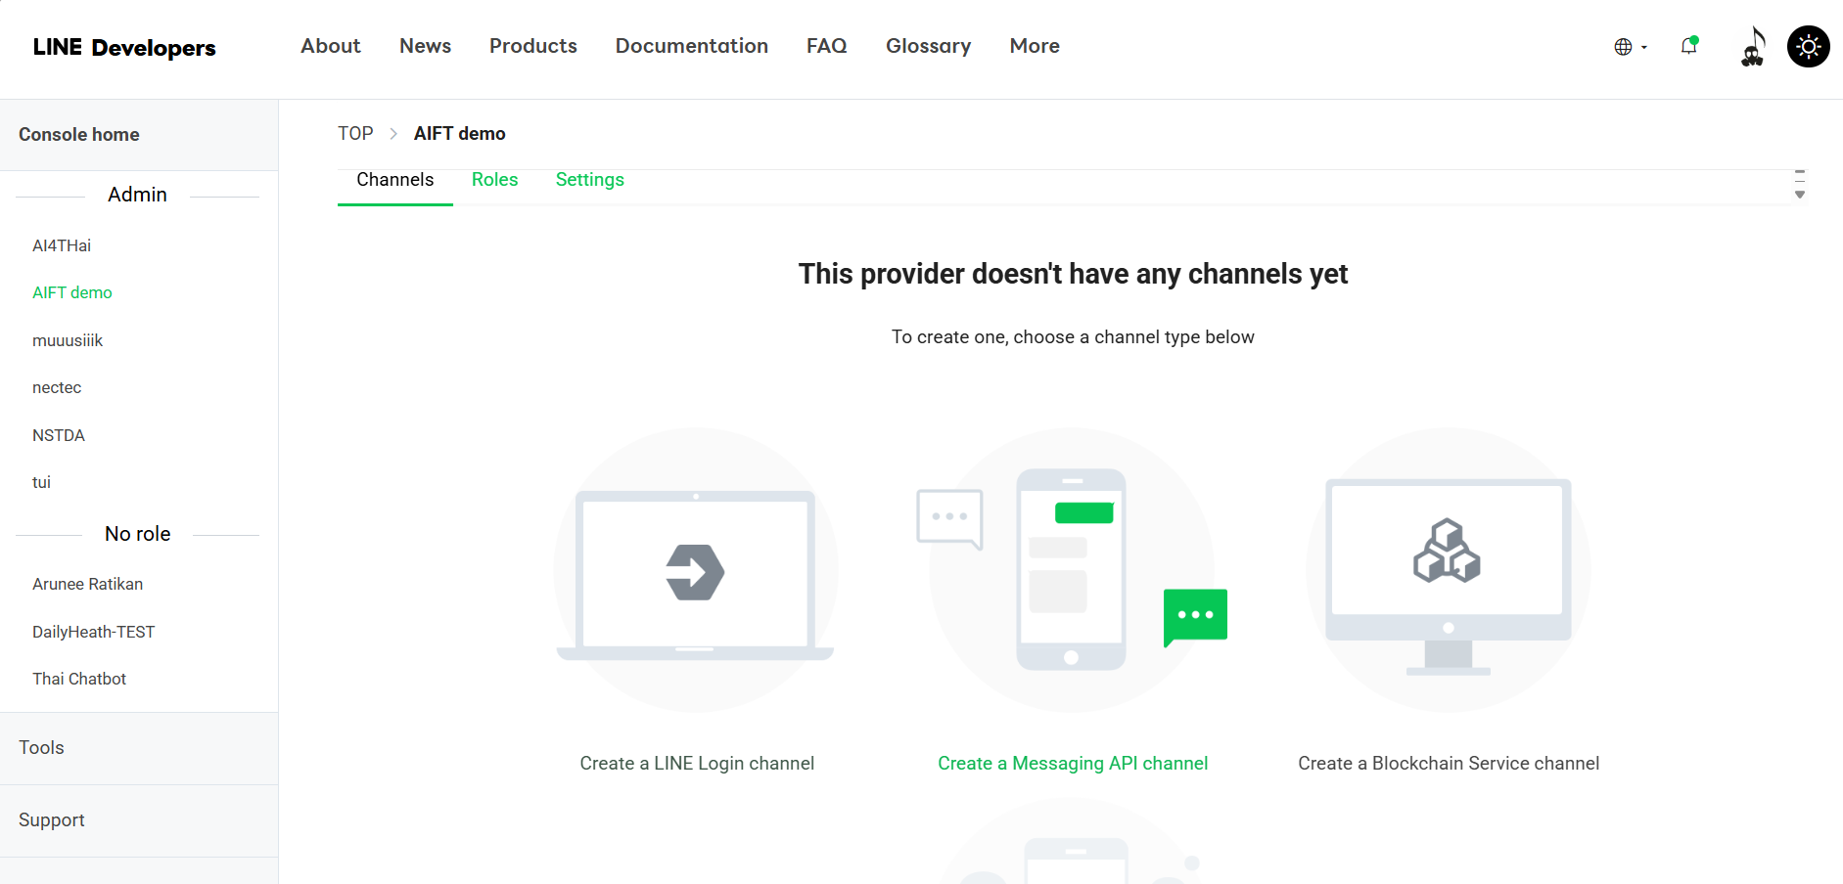
Messaging API

Slide 13
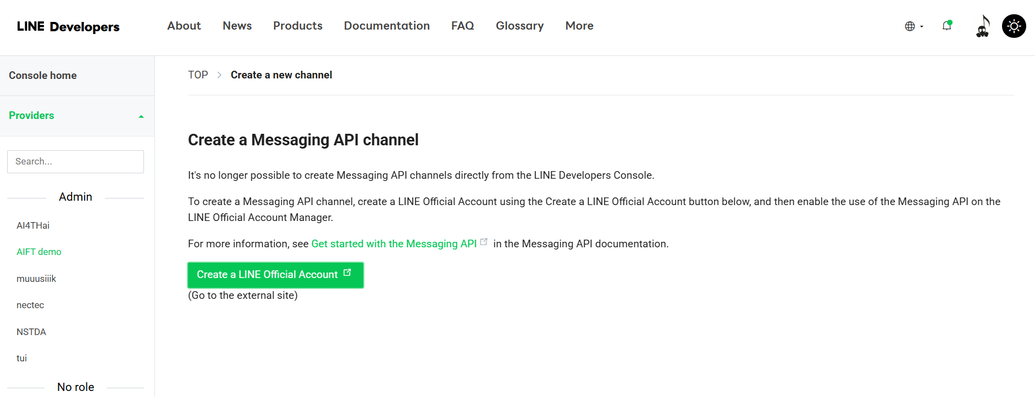

Slide 14
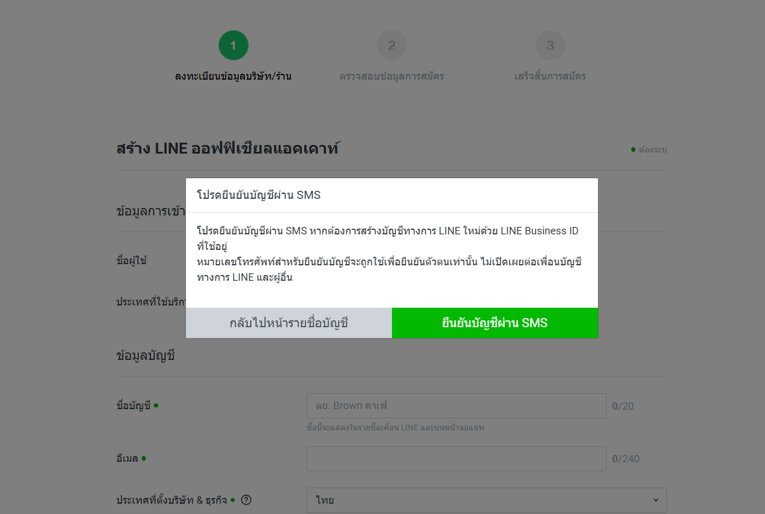
Filling info …

Slide 15
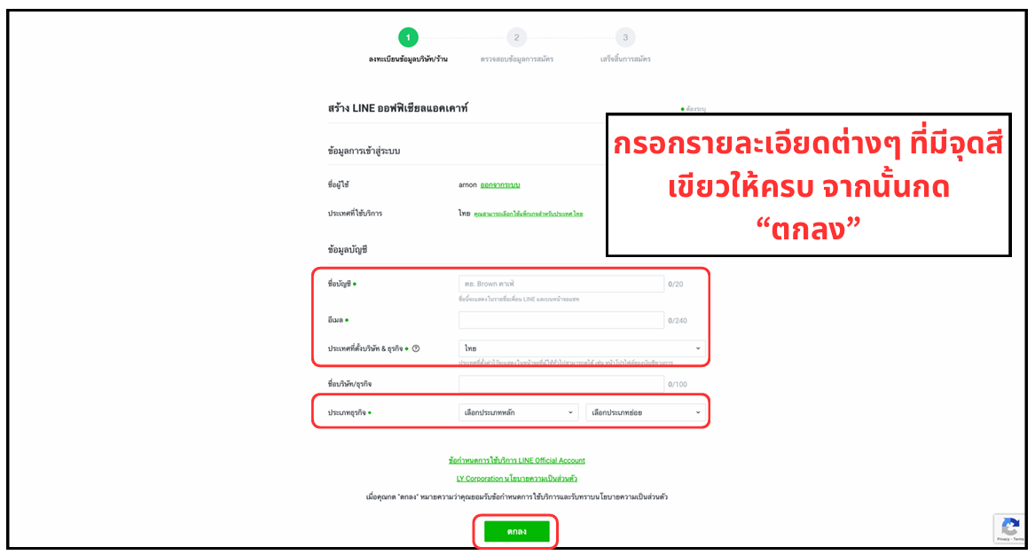

Slide 16
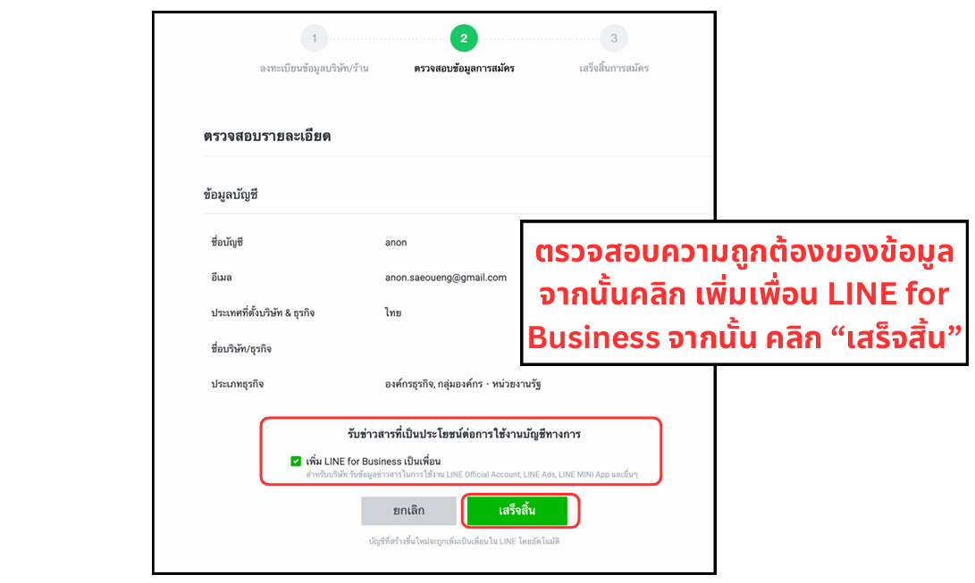

Slide 17
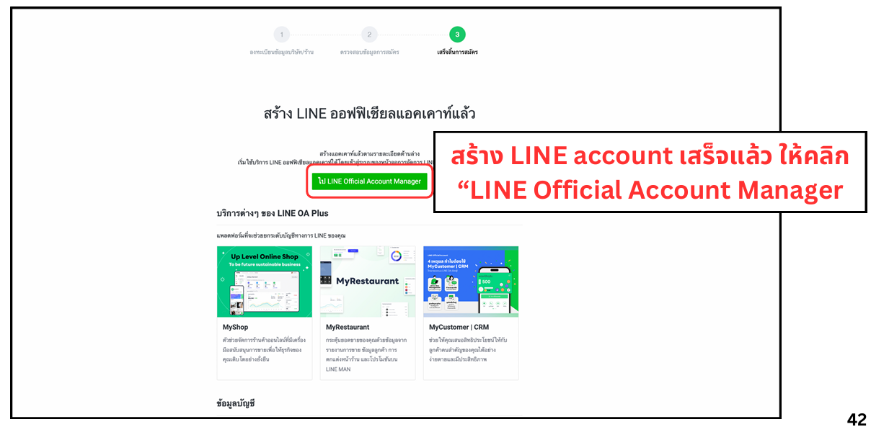

Slide 18
LINE OA

Slide 19
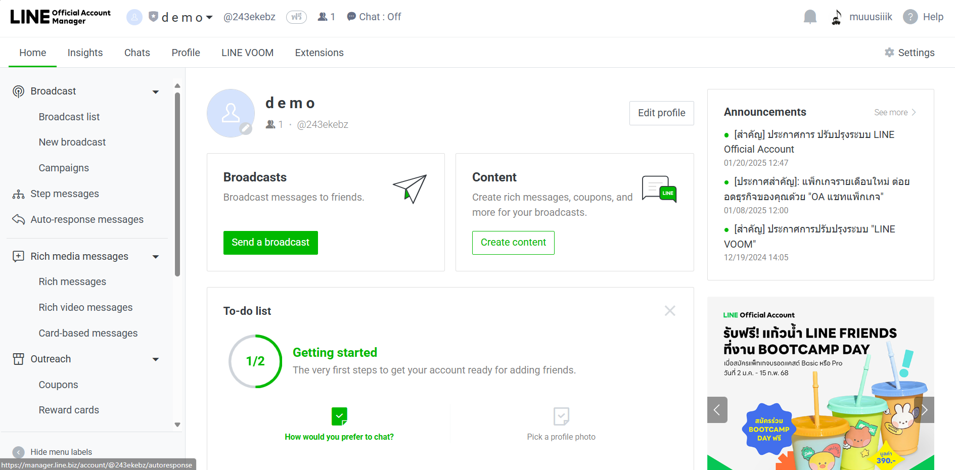
Click “Settings”

Slide 20
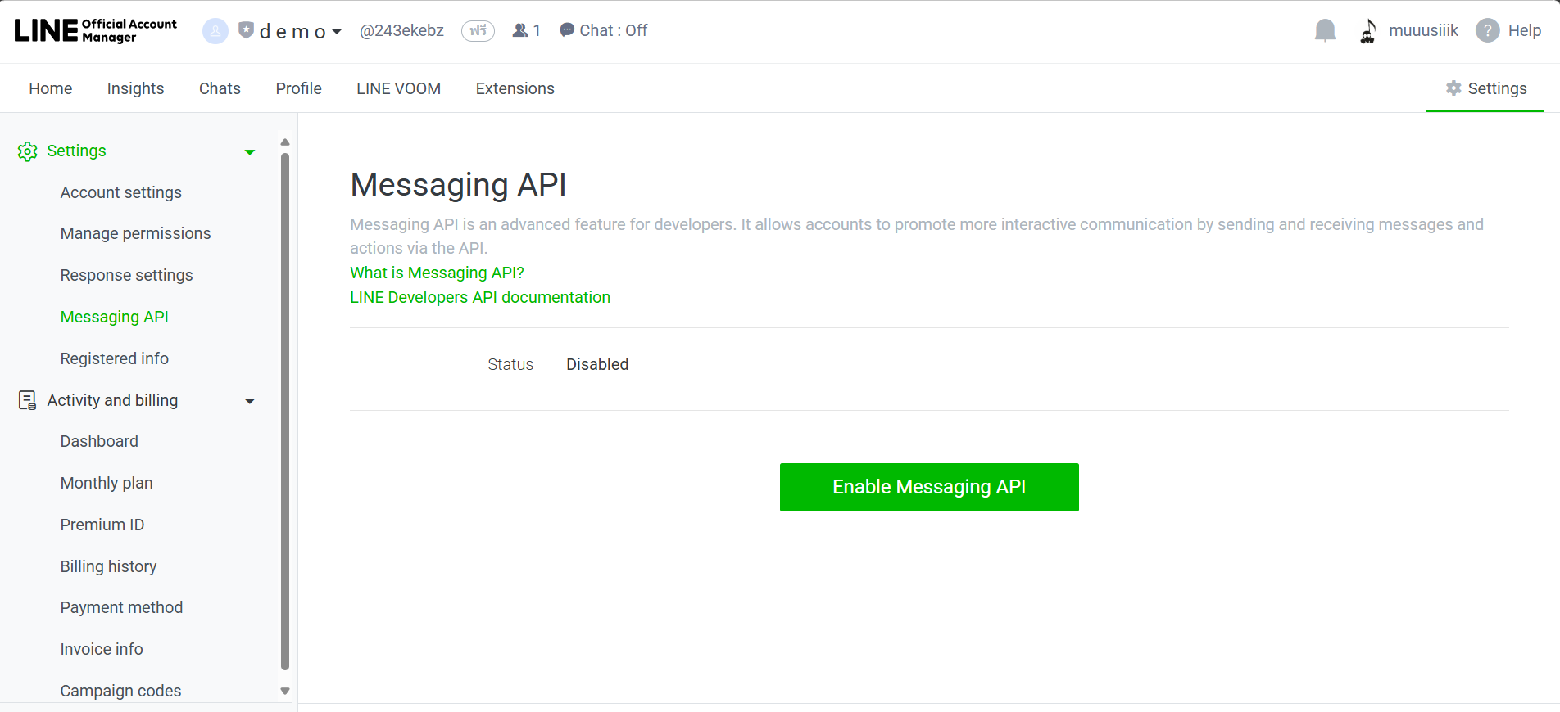
(1)
(2)

Slide 21
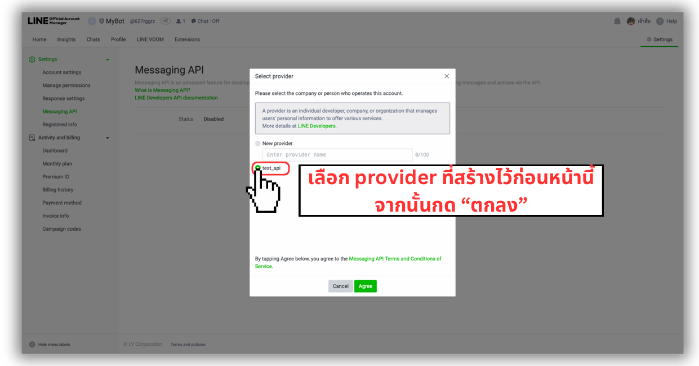

Slide 22
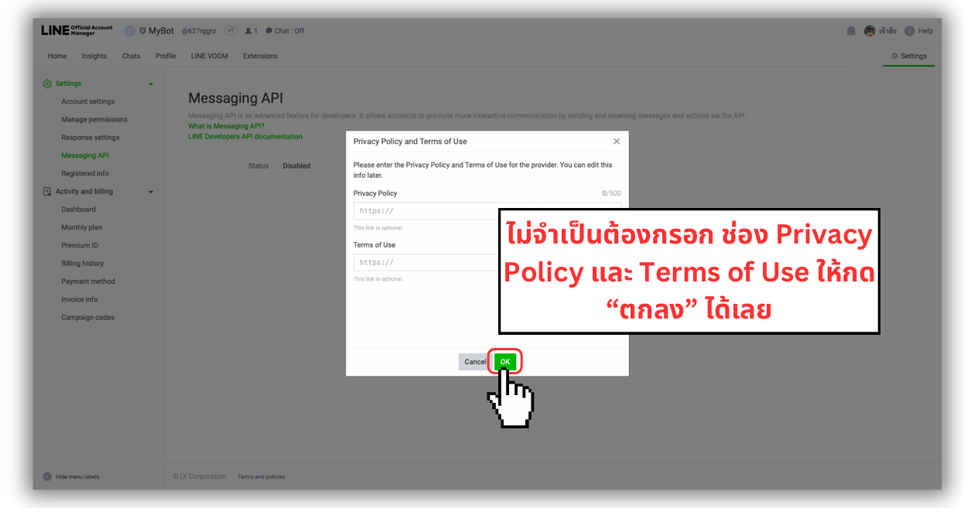

Slide 23
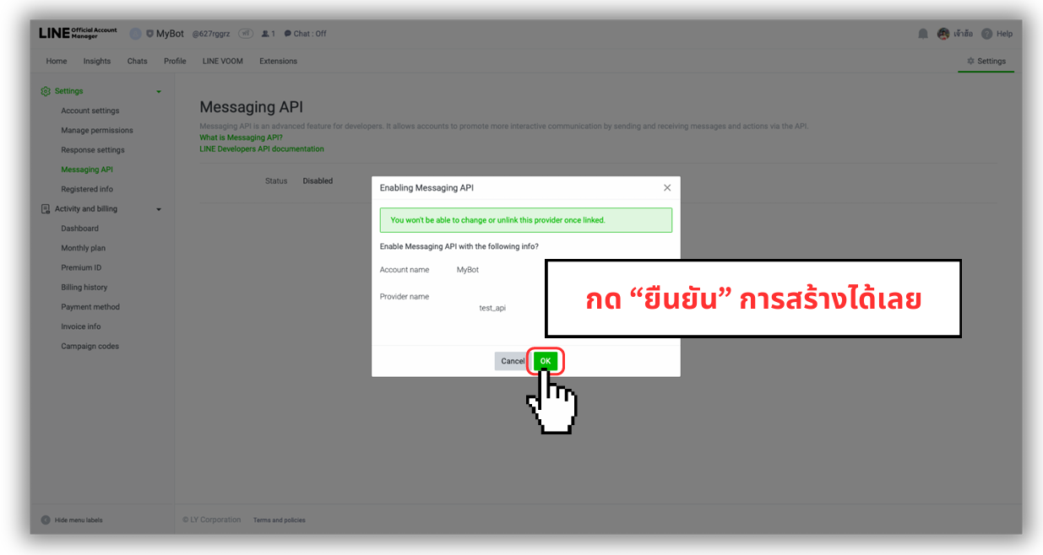

Slide 24
LINE DEVELOPER

Slide 25
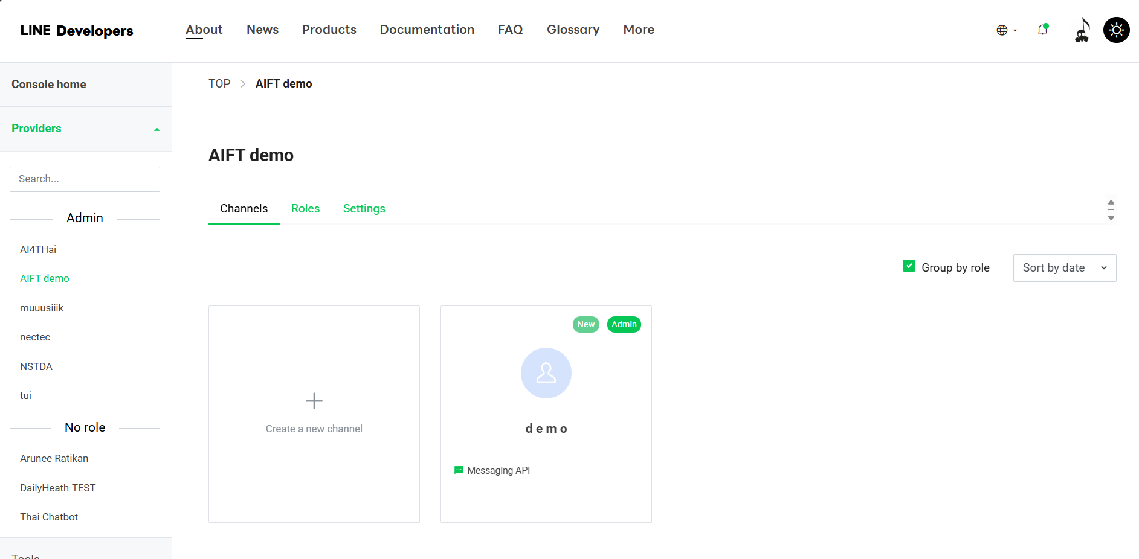

Slide 26
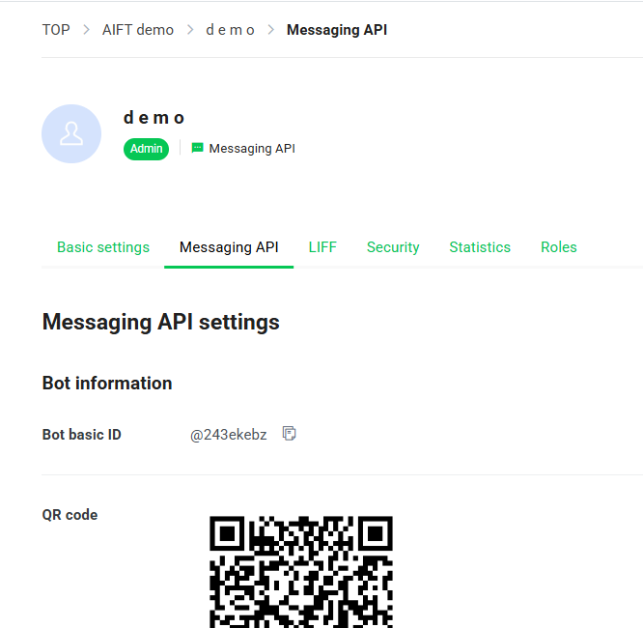
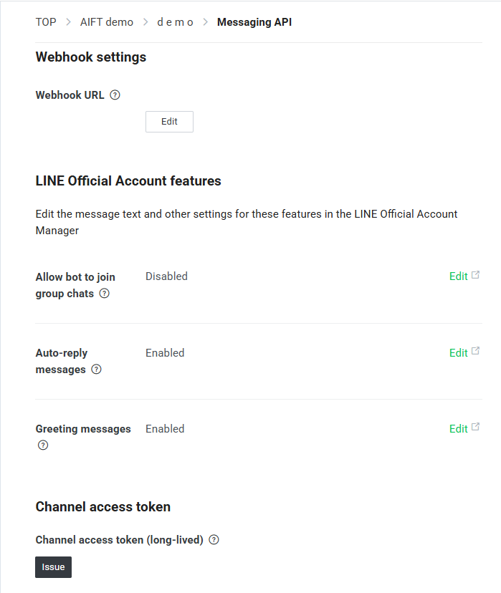

Slide 27
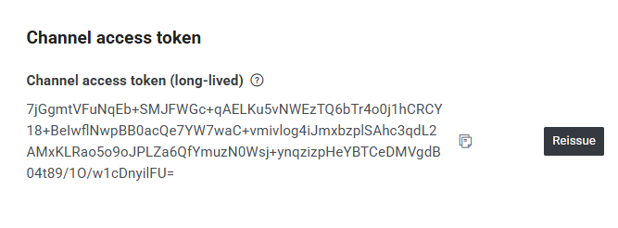
Copy access token
Access token

Slide 28
SIMPLE LINE CONNECTION

Slide 29
https://make.com

Slide 30
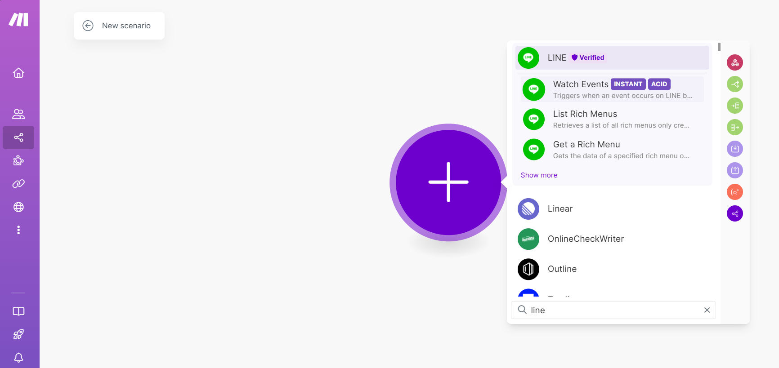

Slide 31
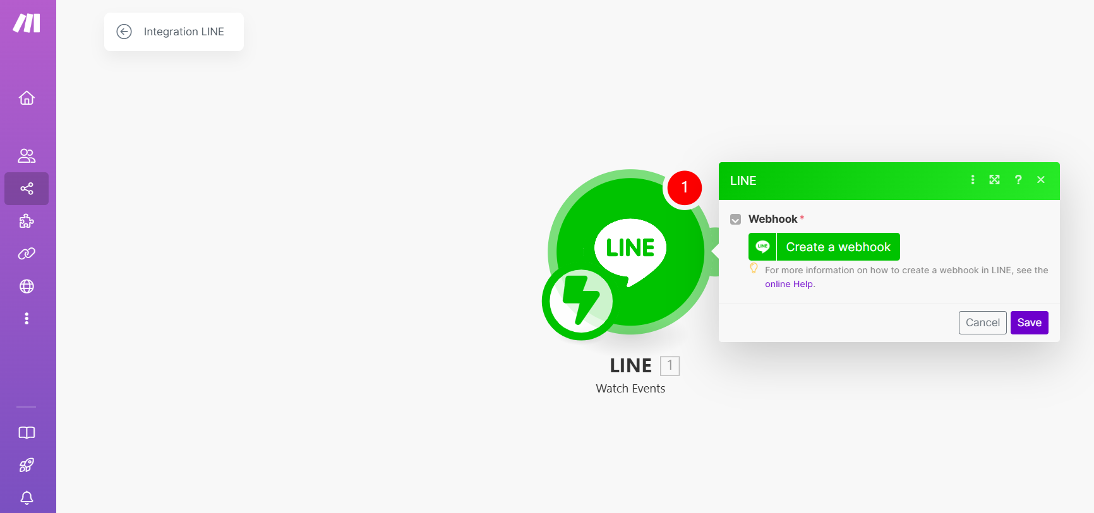

Slide 32
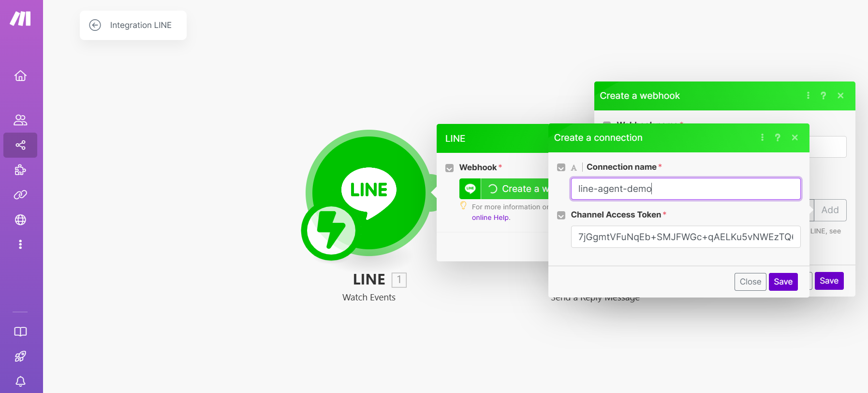
Access token

Slide 33
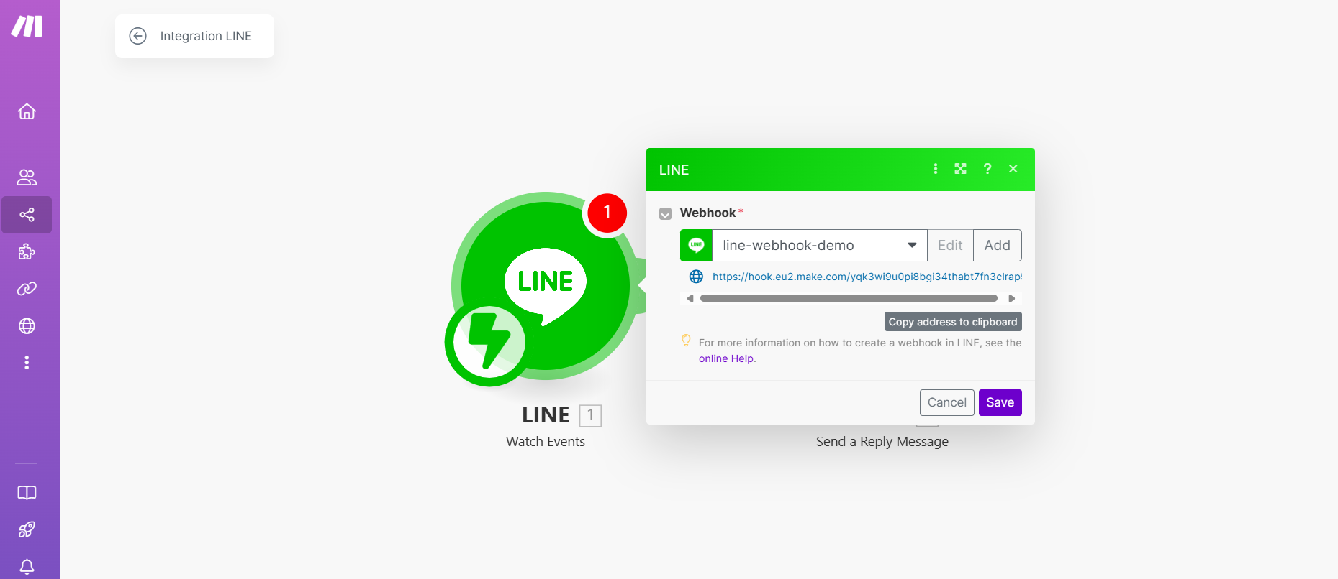
webhook

Slide 34
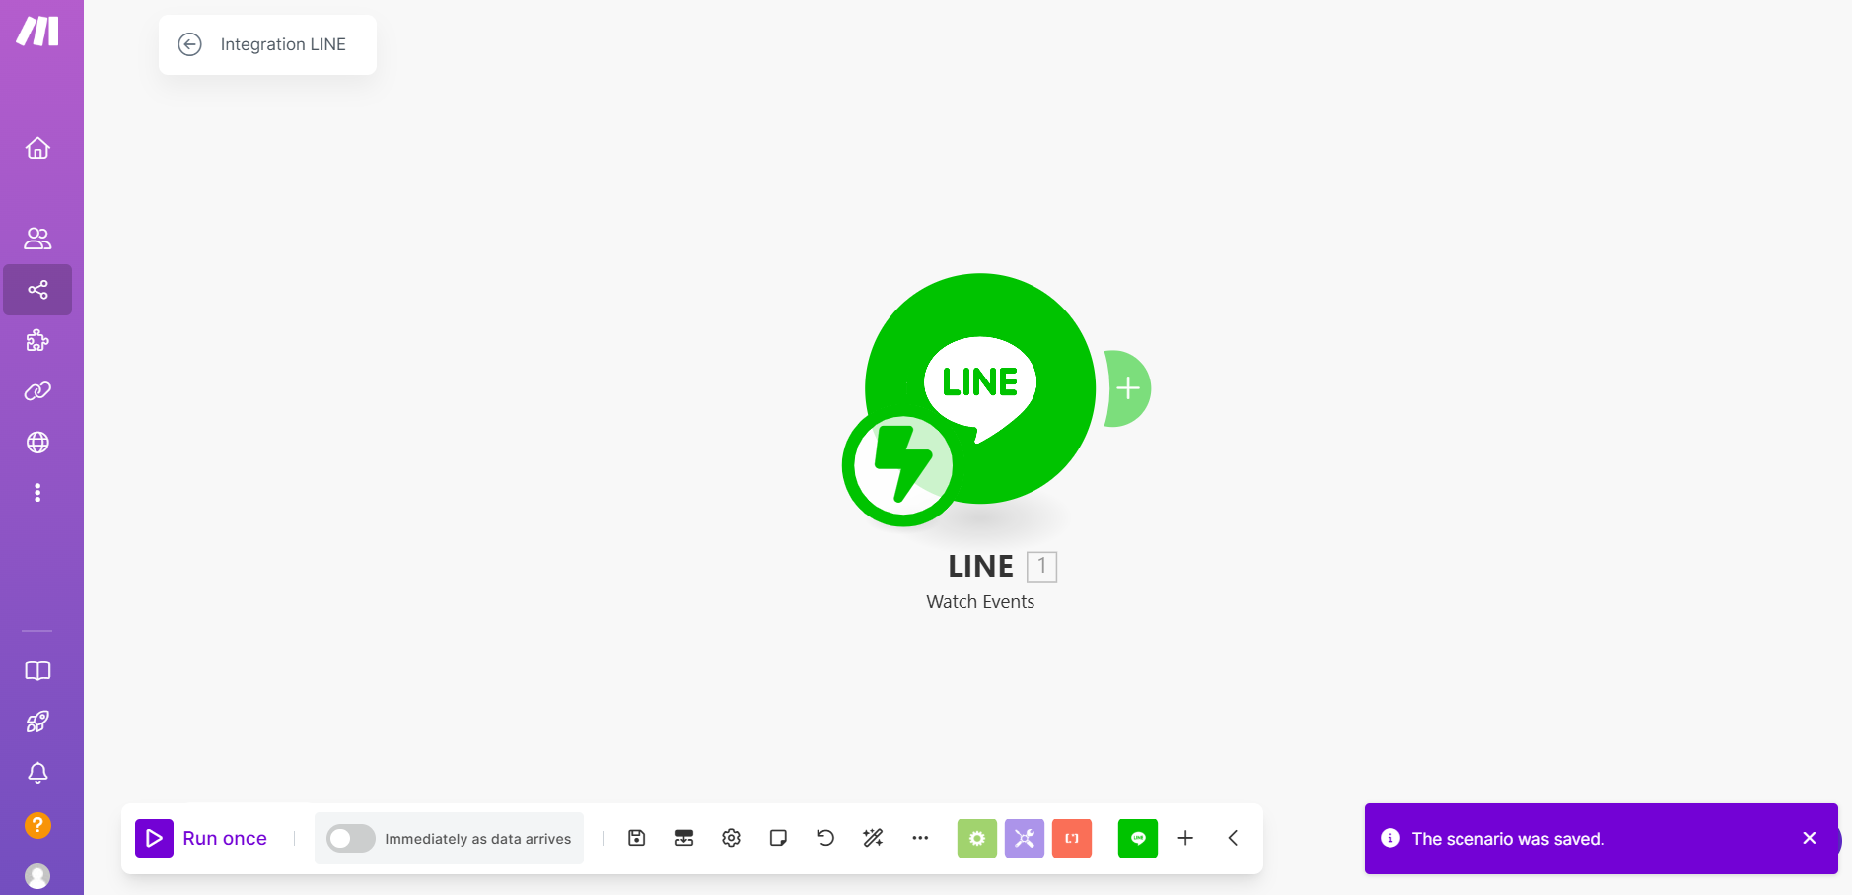
SAVE!!

Slide 35
Linking webhook to LINE
webhook
Access token

Slide 36
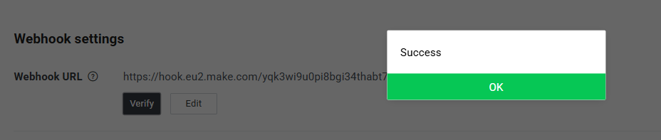

Slide 37
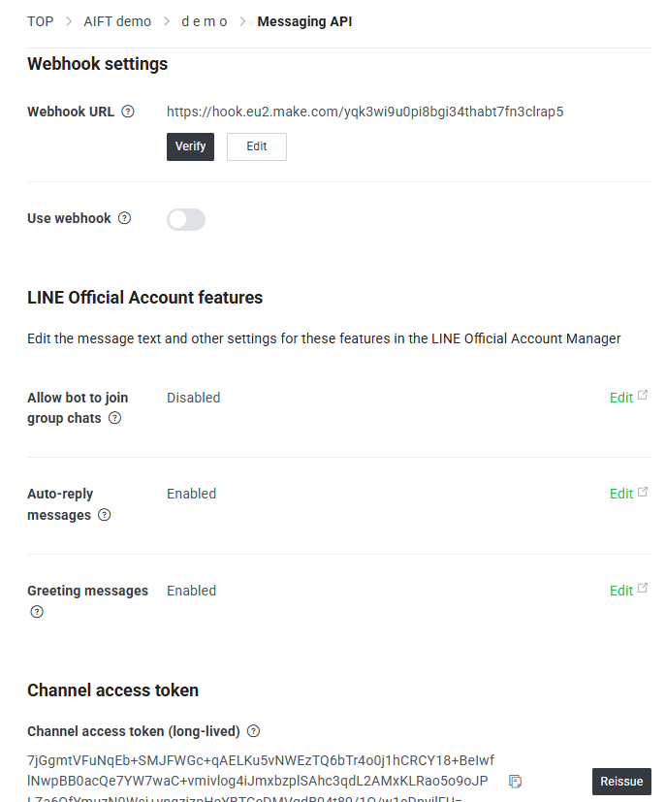

Slide 38
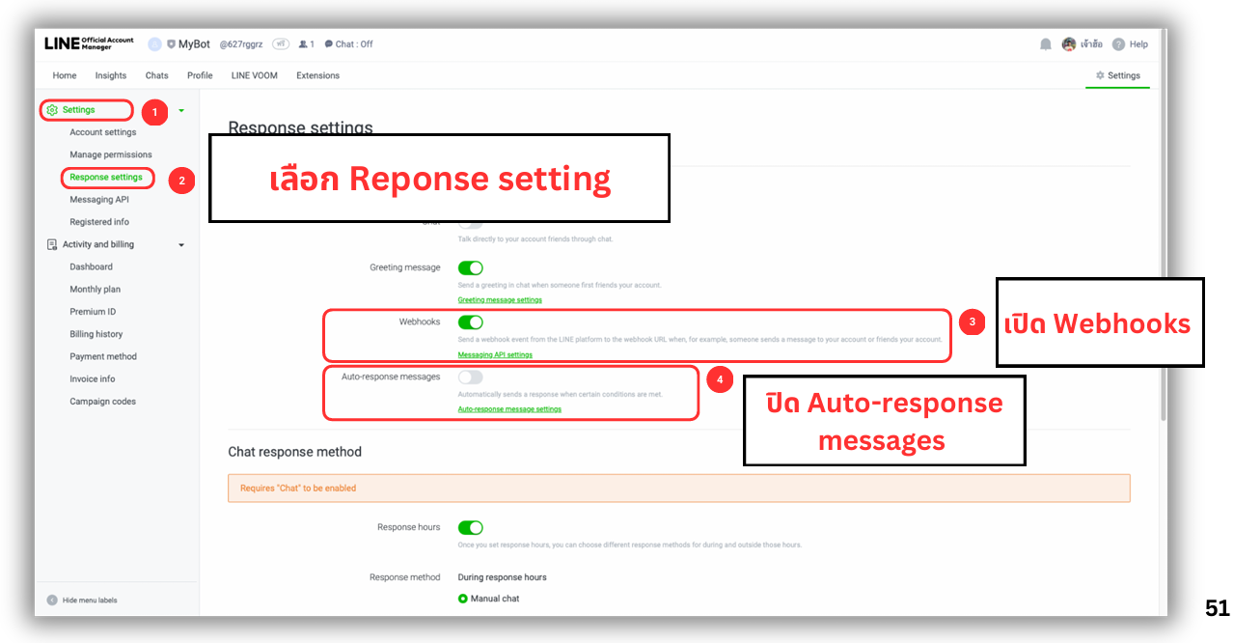

Slide 39
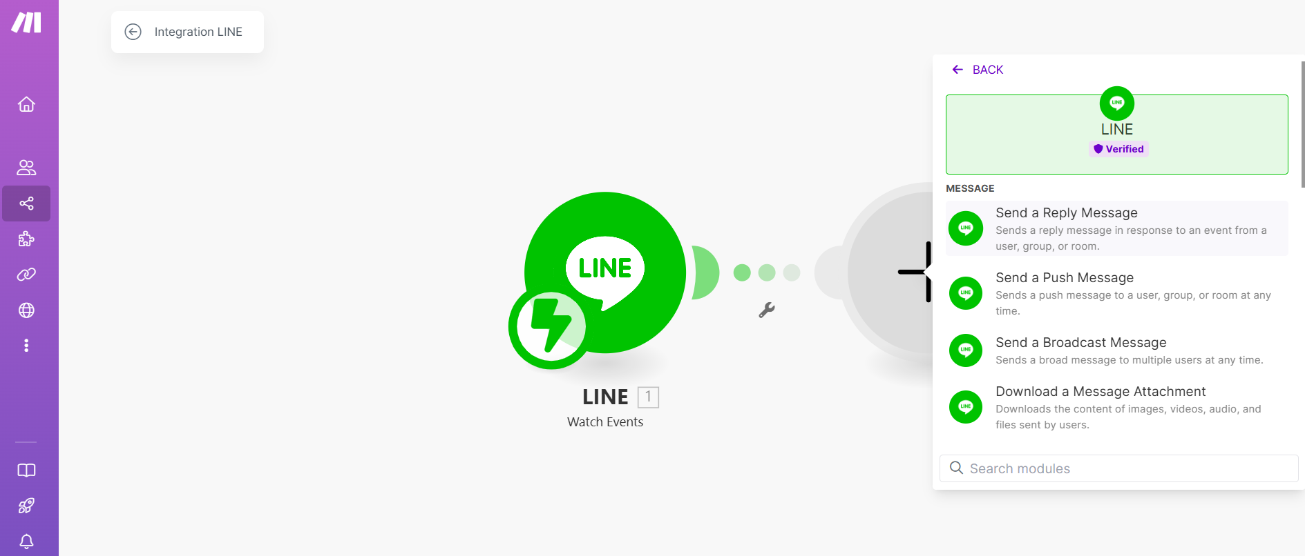
Adding “reply message”

Slide 40
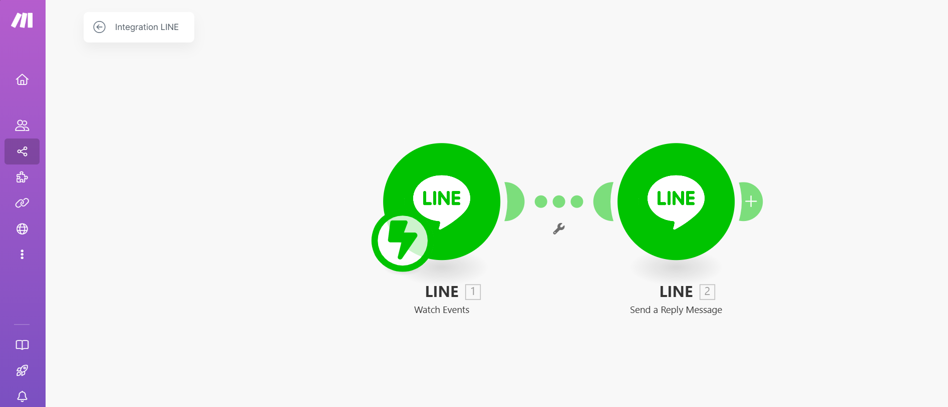

Slide 41
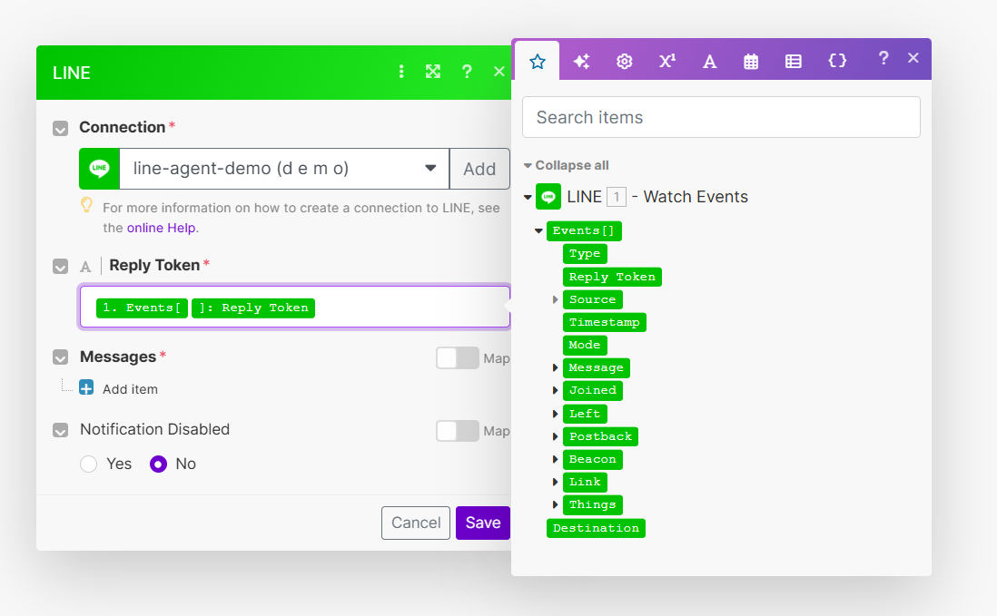

Slide 42
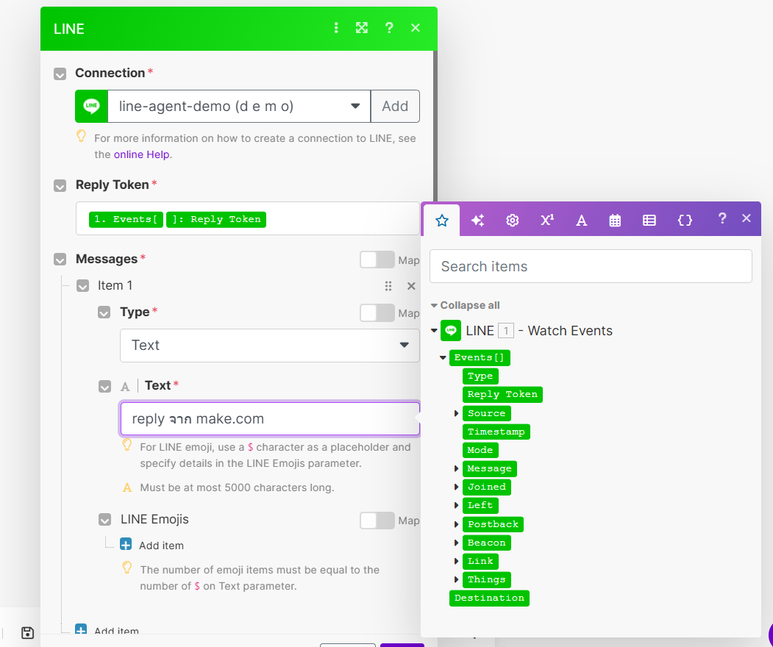

Slide 43
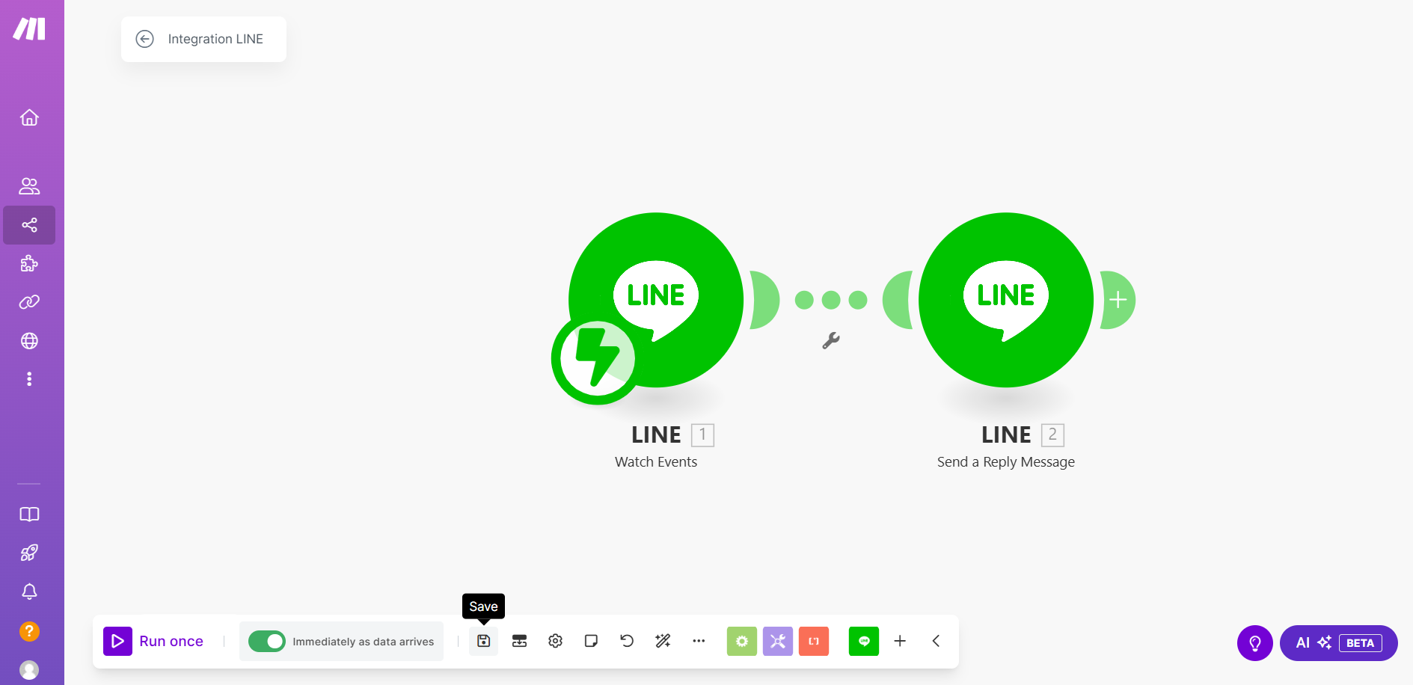
(2)
(1)

Slide 44
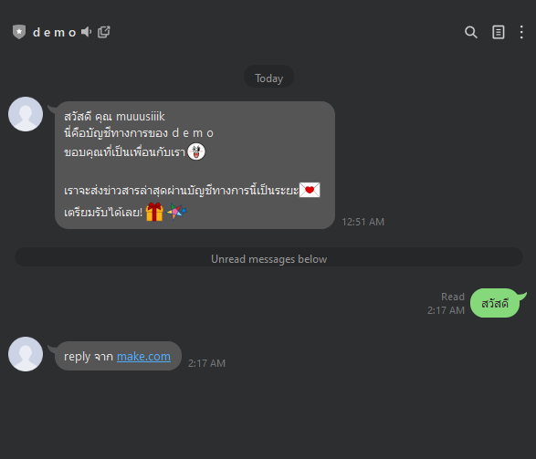

Slide 45
CHAT by LLM

Slide 46
Setup LLM at https://openrouter.ai

Slide 47
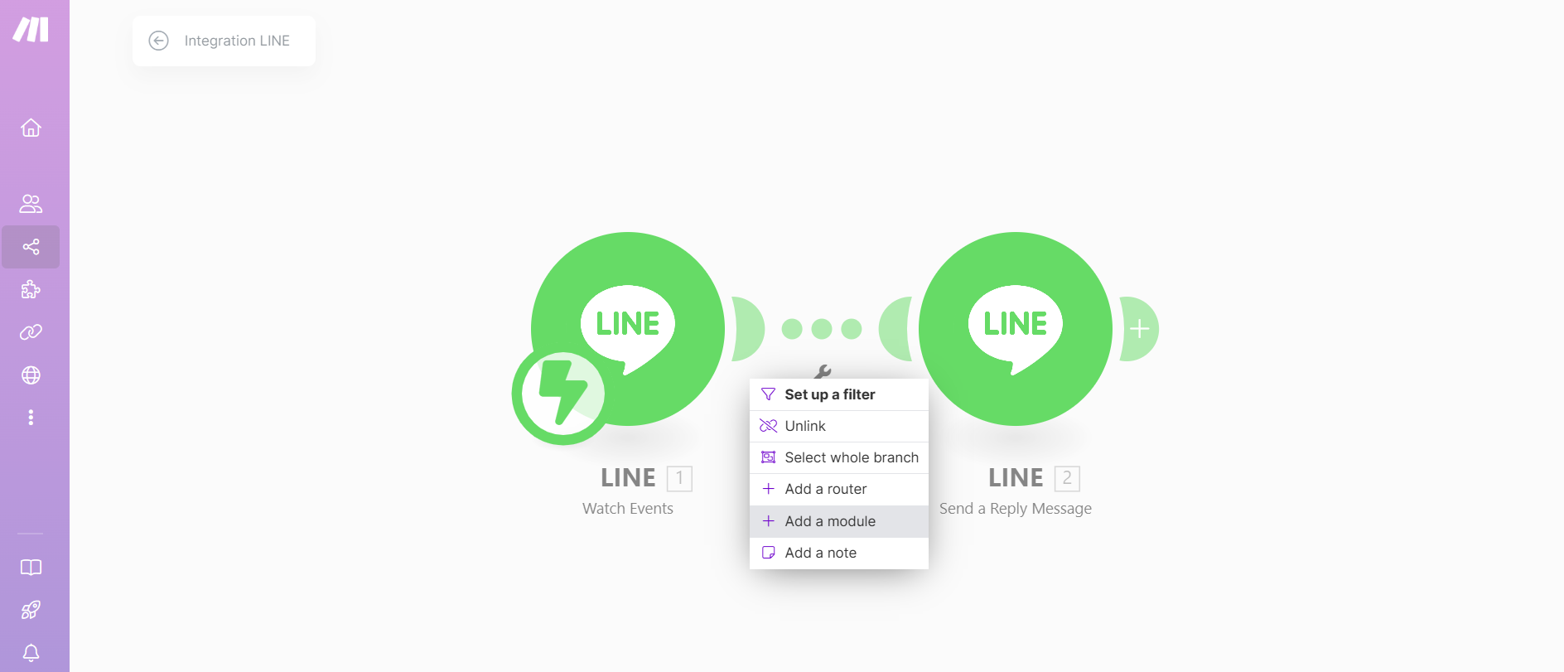

Slide 48
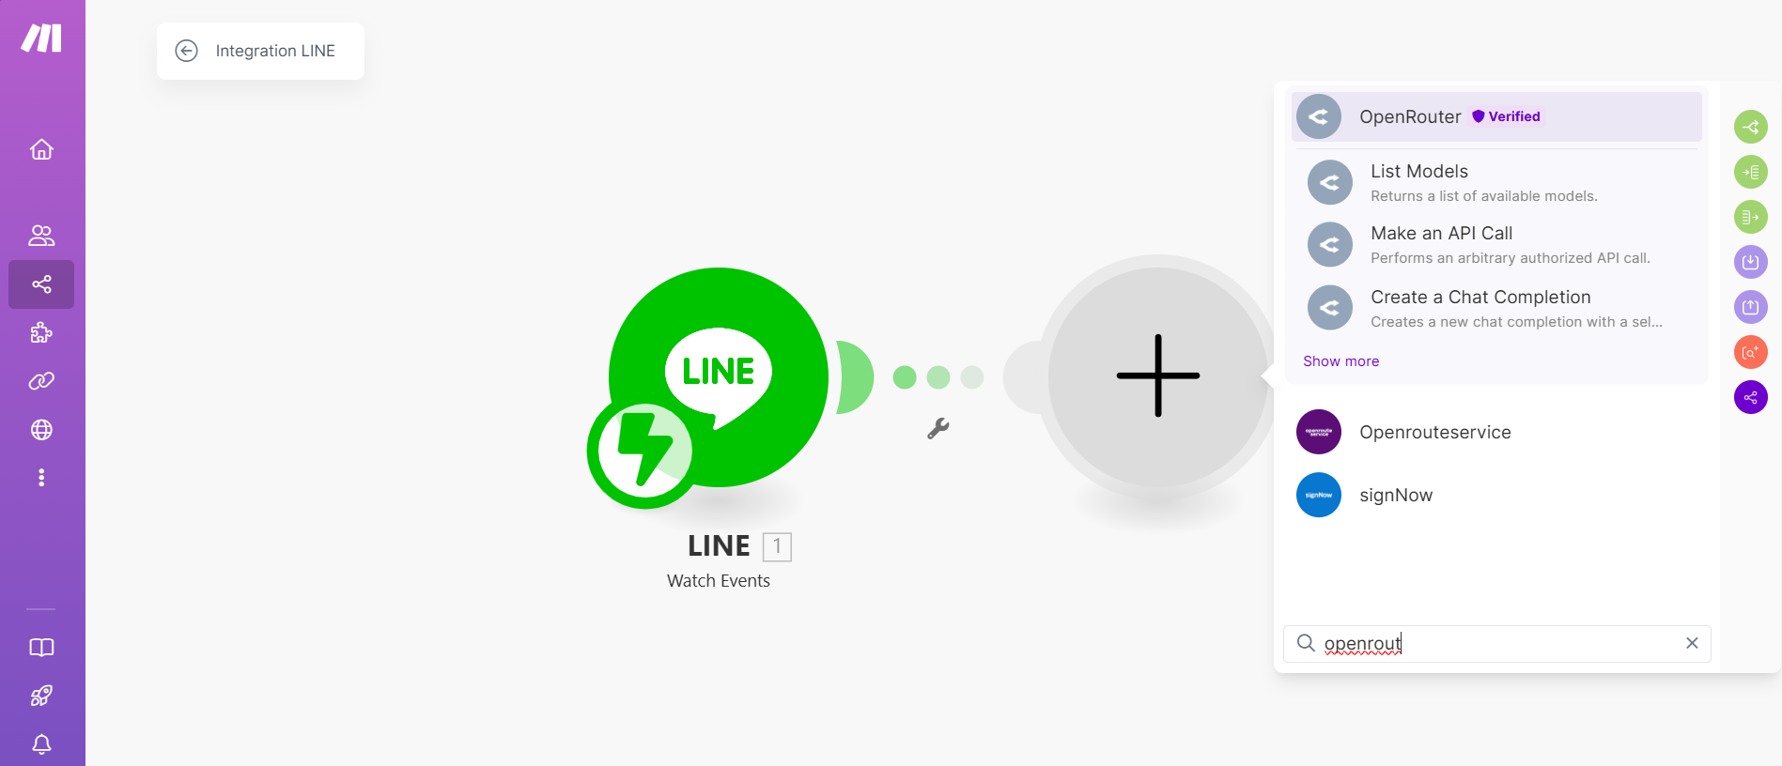

Slide 49
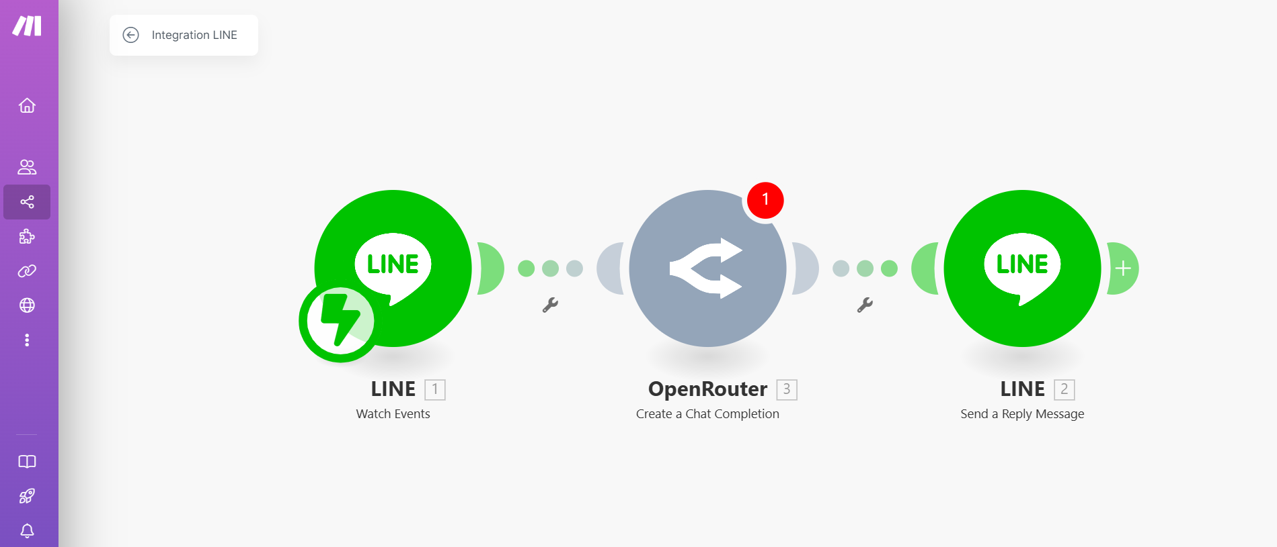

Slide 50
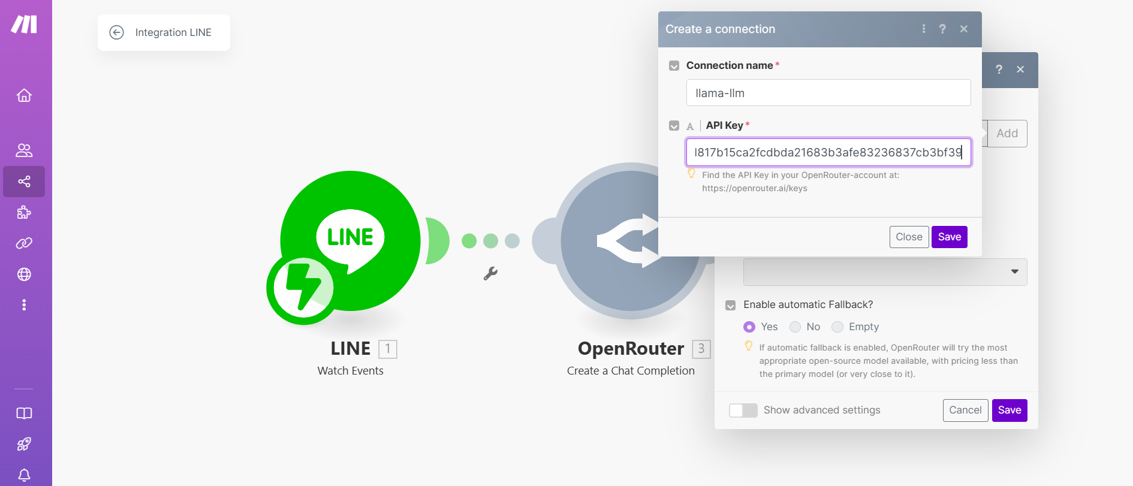

Slide 51
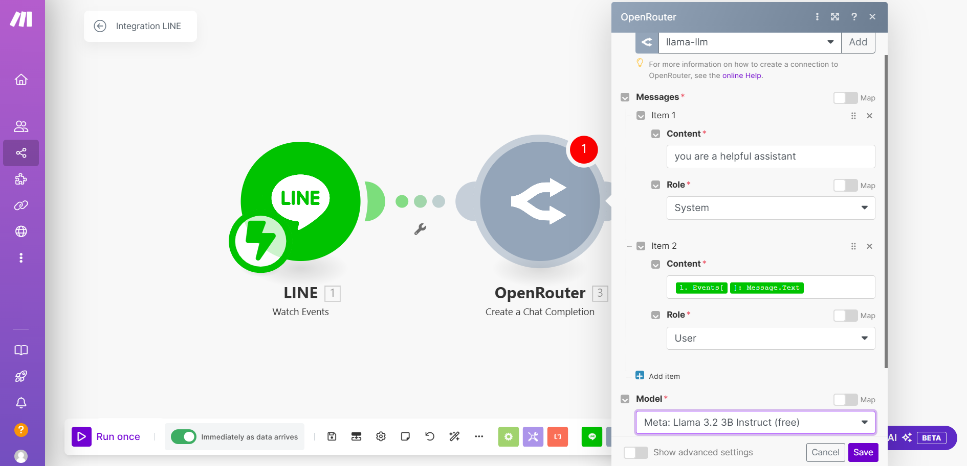
Your selected model

Slide 52
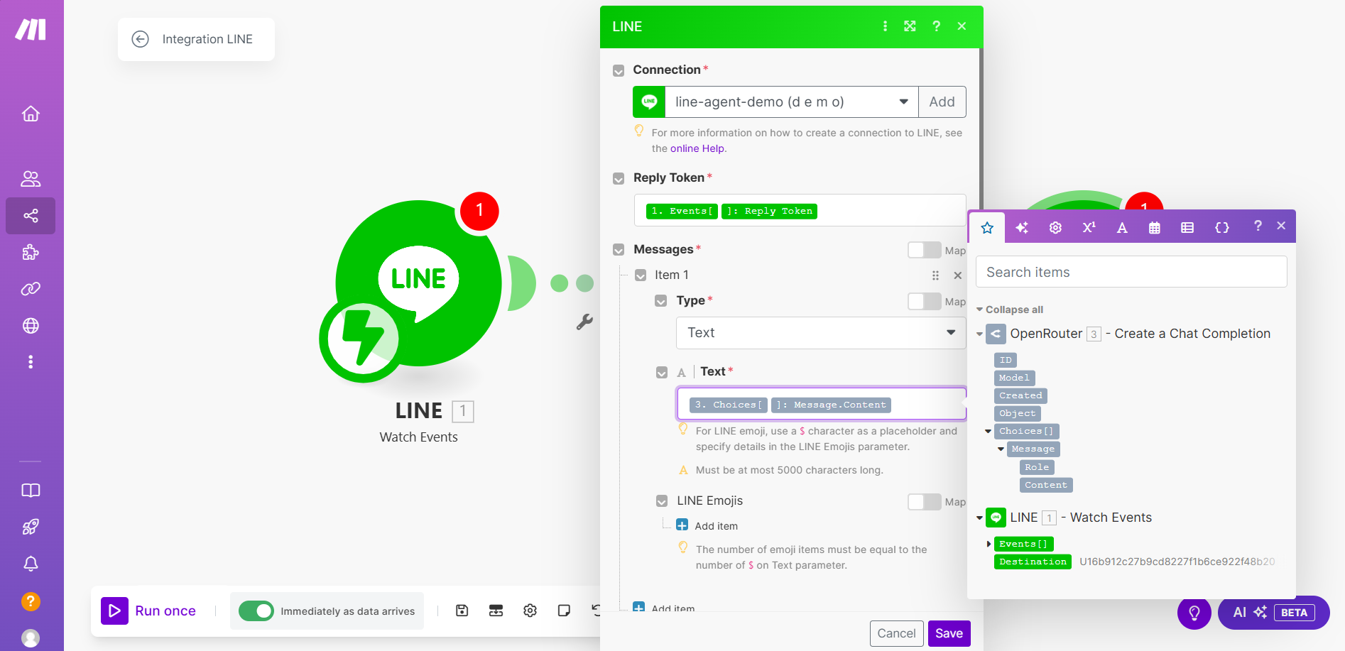

Slide 53
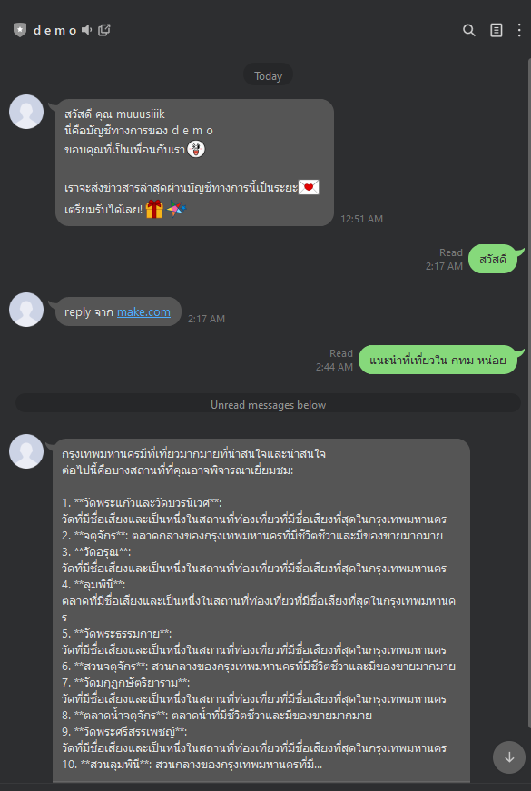

Slide 54
CHAT by RAG

Slide 55
Setup local RAG service
Deploy your service on https://ngrok.com

Slide 56
LOCAL RAG SERVICE

Slide 57
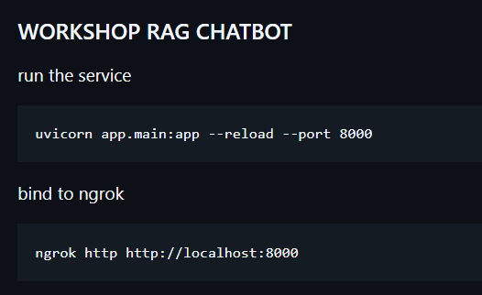
https://github.com/muuusiiik/workshop-rag-chatbot

Slide 58
MODIFY THE FLOW

Slide 59
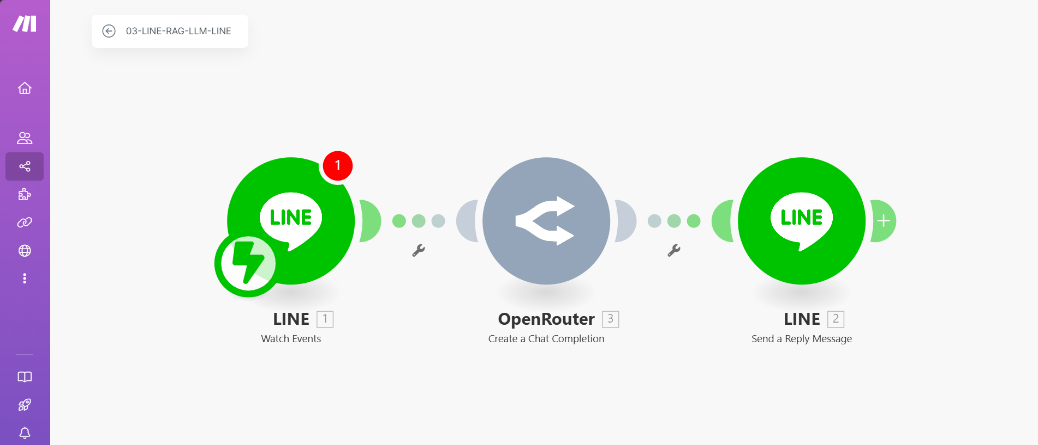

Slide 60
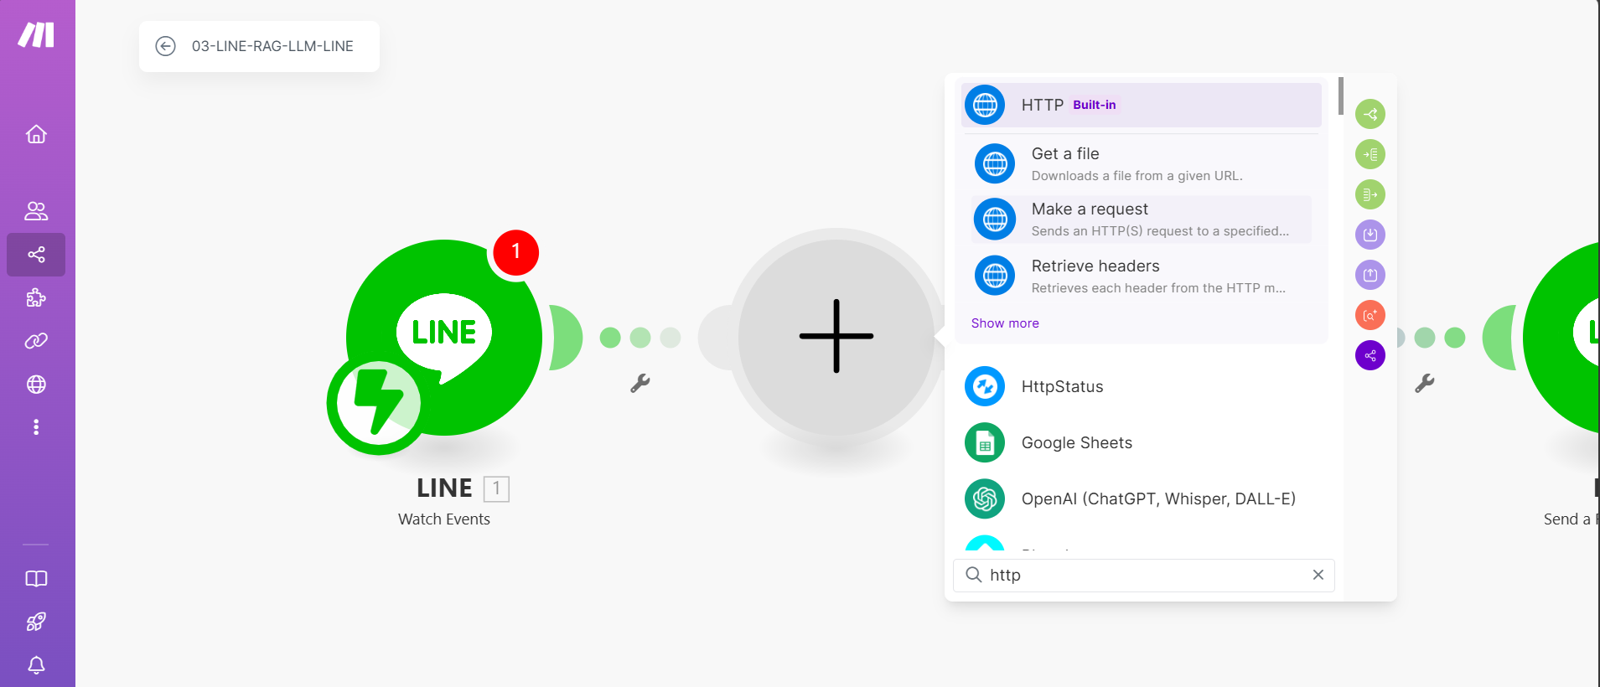
Adding HTTP module

Slide 61
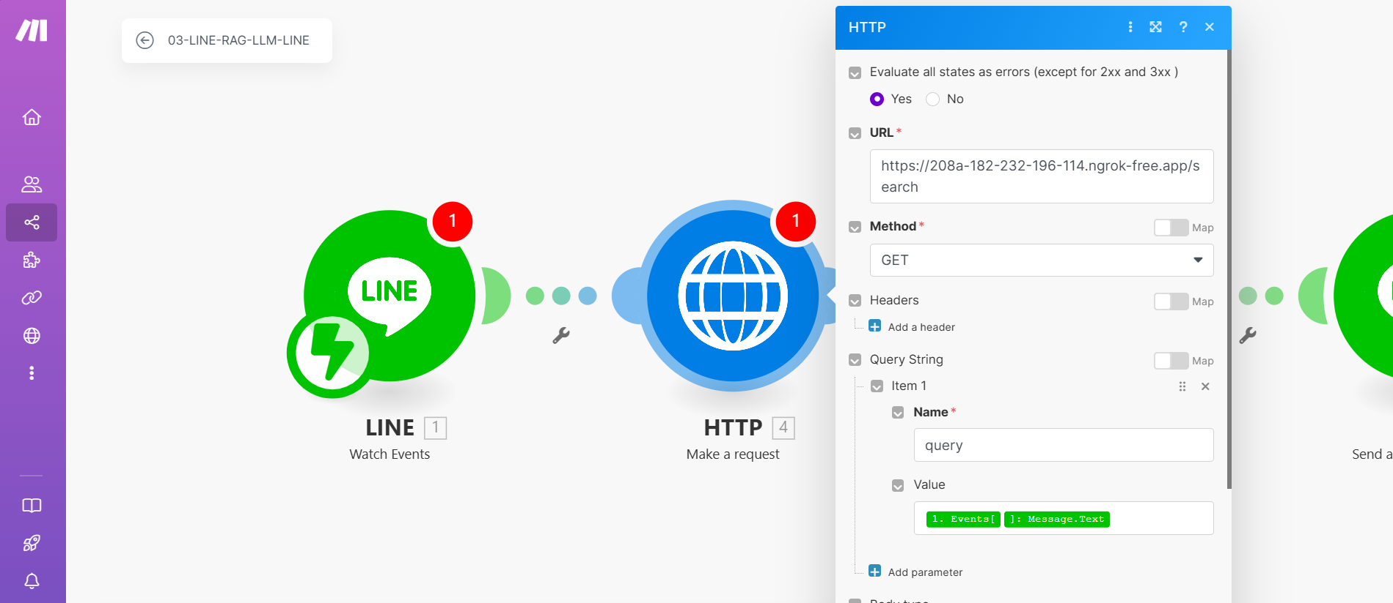
setup HTTP module

Slide 62
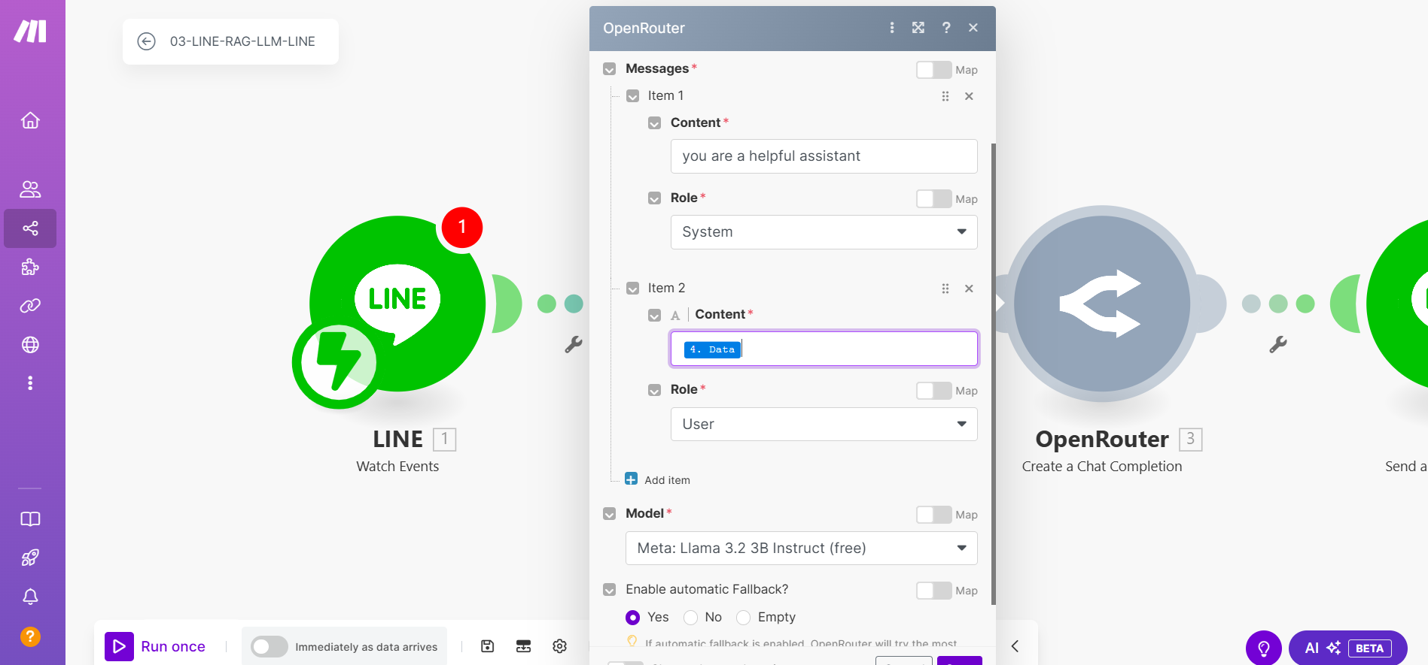
Setup OpenRouter input

Slide 63
